Slide 1
QUALITY OBJECTIVE SETTING WORKSHOP
Introductory
materials for a workshop

Slide 2
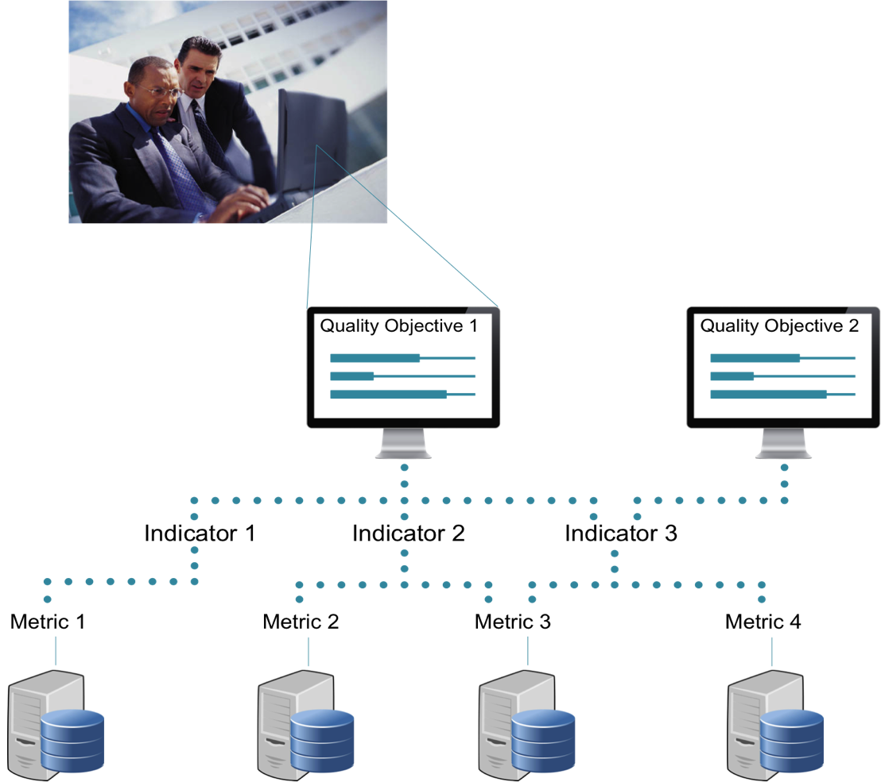
A quality model… what?
“A quality model is a practical definition of quality in a project”
“A quality model includes one or several quality objectives. Quality objectives are described by one or several quality indicators. Quality indicators are measured by quality metrics.”
Notes:
Umbrella term

Slide 3
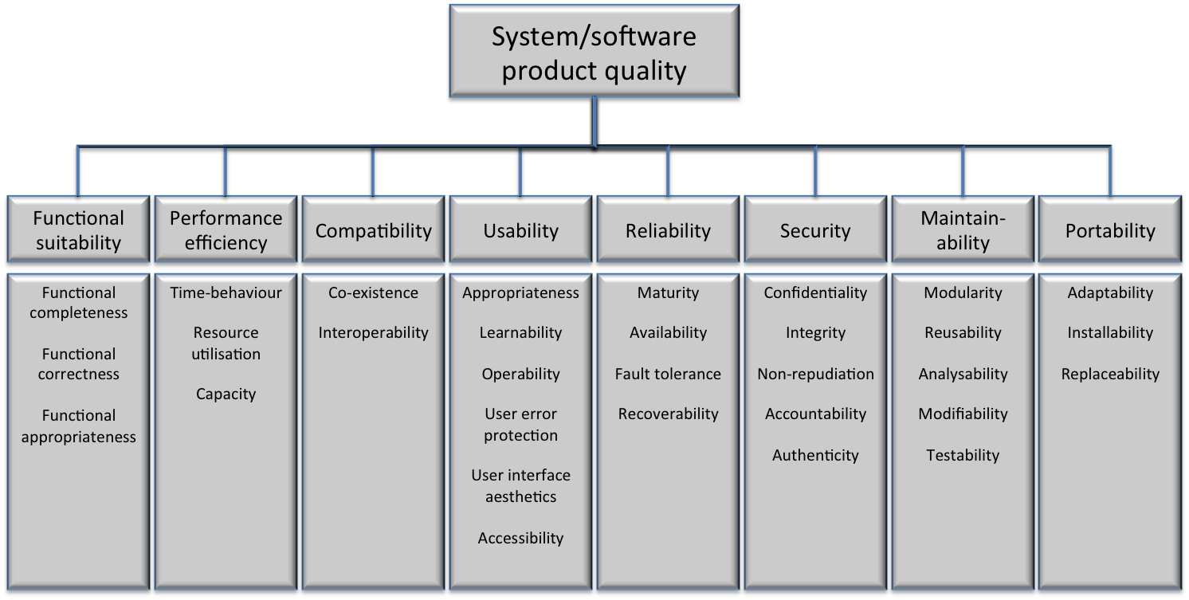
Product Quality objectives
“A quality objective is a high-level viewpoint to a certain characteristic”
By ISO/IEC 25010 Quality model (ISO/IEC 2010)

Slide 4

Process Quality objectives
“A quality objective is a high-level viewpoint to a certain characteristic”
RE process
conformance
Test process
conformance
Standard & policy
conformance
Contract conformance
Schedule
conformance
SW development process conformance
Notes:
Process quality affects the product quality.

Slide 5
Quality indicators
“A quality indicator is a link between the actual measurement and the quality objective”
“Indicates, whether the objective is reached”
How to define quality indicators?
Think about
What factors affect the objective?
What indicates the status of the objective?
Notes:
Based on the feedback we have gotten after testing the methodology, indicators have been the most difficult concept to understand. That’s why we have prepared these slides, to make it clearer to you.

Slide 6
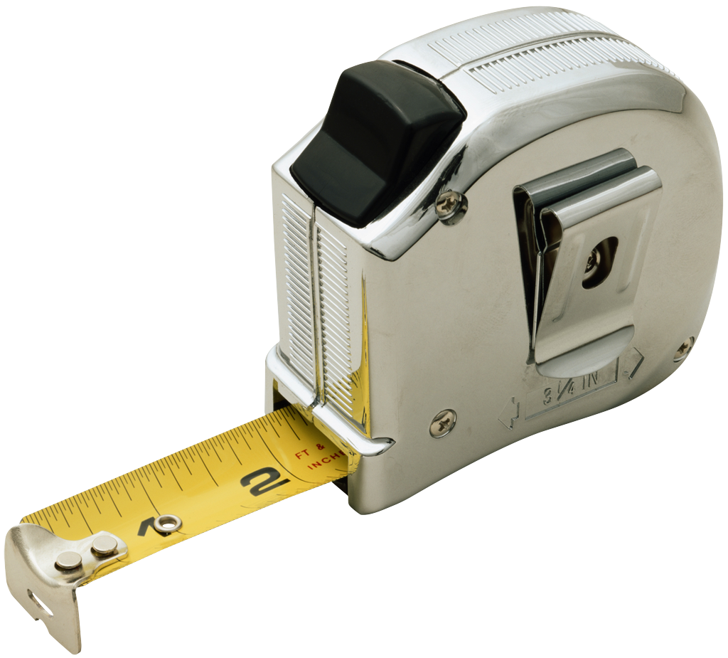
Quality metrics
“A quality metric is the actual, concrete measurement”
How to define quality metrics?
Think about
In what ways could the indicator be measured?
What data is needed for making the indicator visible?
What is the concrete artifact that is used?
E.g. a source code module or feature or project
What / how wide is the focus?

Slide 7
example!
QUALITY MODEL
Quality objective:
Functional correctness
Quality objective:
Accountability
Indicator 1: Defect rate
Indicator 2: Test coverage
Indicator 1: Software steadiness
Metric 1: Fix rate
Metric 2: Amount of open blocker defects
Metric 1: TLOC / LOC
Metric 2: Control structure coverage
Metric 1: Crash interval

Slide 8
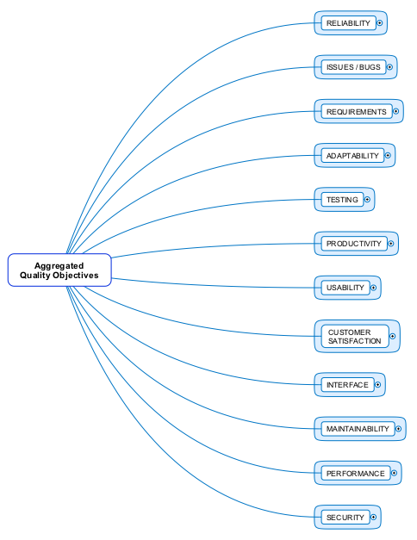
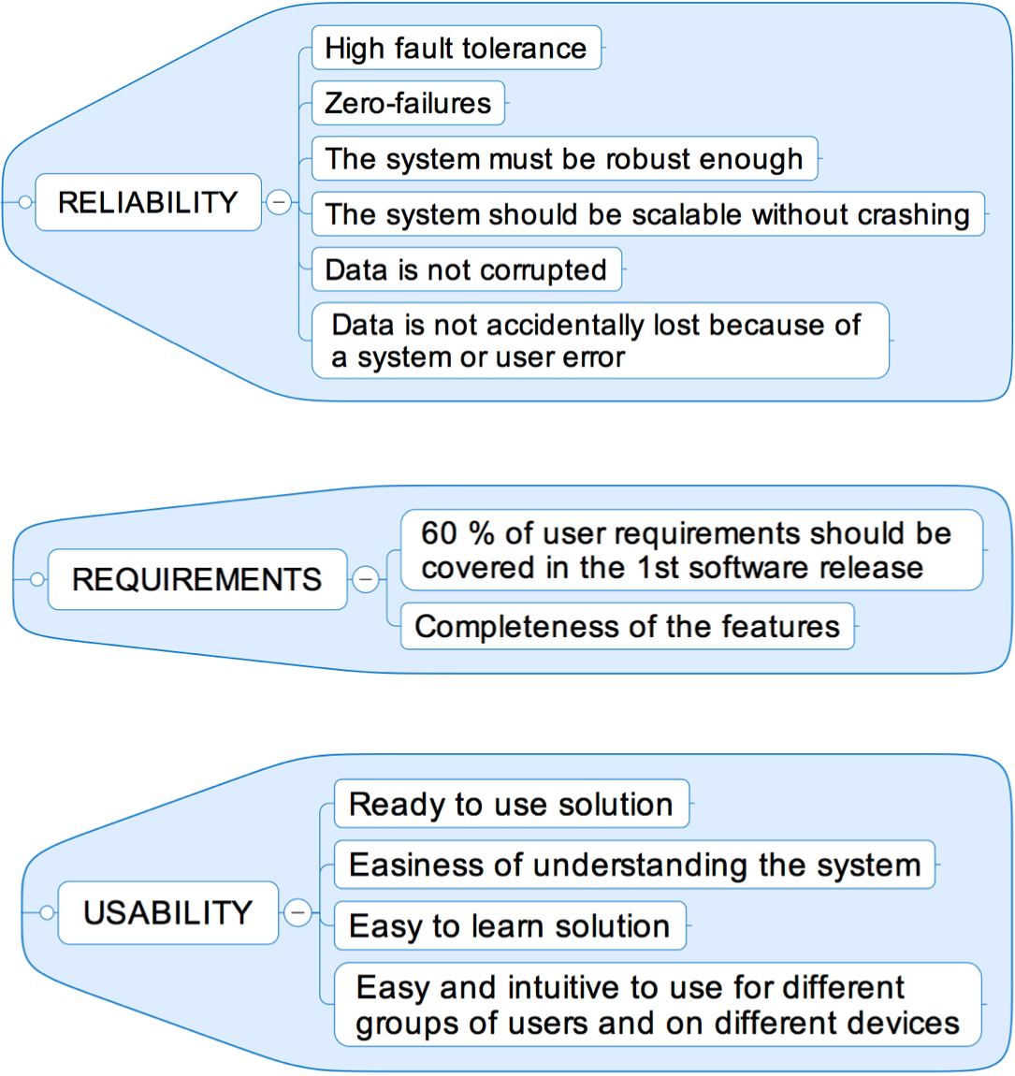
example
Outcome of an early phase test workshop

Slide 9
THE Workshop
What does QUALITY mean
in YOUR project
?

Slide 10
QUALITY OBJECTIVE SETTING workshop
Inputs
Stakeholders
Expertise
Existing measurement data
Quality model
Preparation
Brainstorming
→ Quality objectives
Prioritization of objectives
Elaboration
→ Indicators & metrics
Post-activities → Conclusions
Prioritization
of indicators
WORKSHOP
Outputs
Quality objectives
Measures for objectives
Shared understanding of quality

Slide 11


SteP 0: Preparation Before starting the workshop
15 min
Short reminder of the workshop method
Guidelines on hand-out
Prepare your workshop space
Post-Its, whiteboard, pens, etc.

Slide 12
STEP 1: Brainstorming Defining quality objectives
60 min
Use 30 minutes to write down the quality objectives
Both product- and process-related
Use Post-It notes
Name and describe the objective
Use 30 minutes to present and organize the objectives
Put the Post-Its on a whiteboard
Group similar Post-Its
Give a high level name for each group

Slide 13
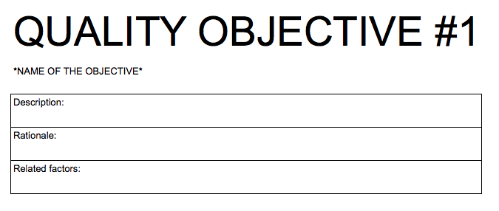
STEP 2: Prioritization Voting on the importance of the objectives
5 min
Defining the most important quality objectives
Voting on the quality objective groups
Three votes per each participant
Use tally marks:
Proceeding further with the most important ones
How many?
Empty documents ready to be filled
Notes:
The amount of the quality objectives taken into consideration depends on the amount of the people in the workshop.
Prepared materials

Slide 14
STEP 3: Elaboration Defining quality indicators and metrics for the quality objectives
120 min
There is a workstation for each Quality Objective
Laptop with Google Drive
What to do?
Choose a quality objective
Go to the laptop reserved for it
Design quality indicators and their metrics
By filling in the Quality Objective Template
As many as you can

Slide 15
STEP 3: Elaboration Defining quality indicators and metrics for the quality objectives
40 min
At the end, each template is presented
You will present the template that you started with
Carefully study other people’s work
Discuss the value of the results

Slide 16
Quality objective templates
http://tinyurl.com/QOTEMPLATE

Slide 17
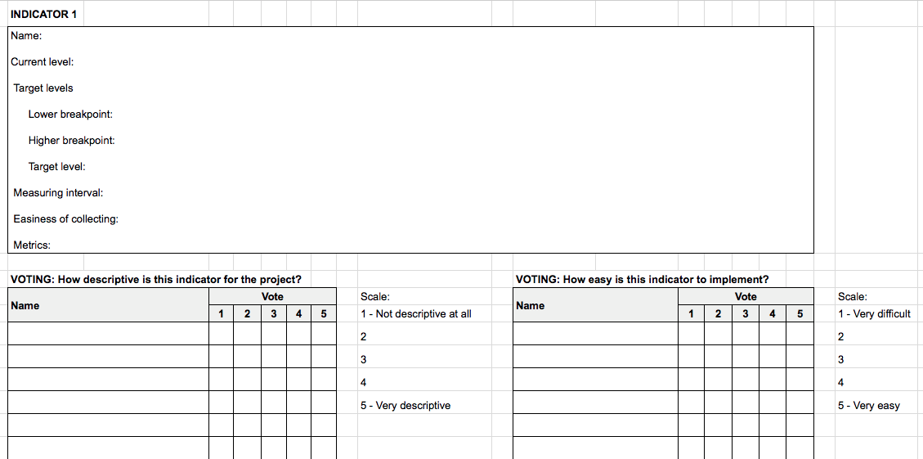
Quality objective template
Cover page for each OBJECTIVE:
Template for each INDICATOR:
General instructions for filling in the template

Slide 18
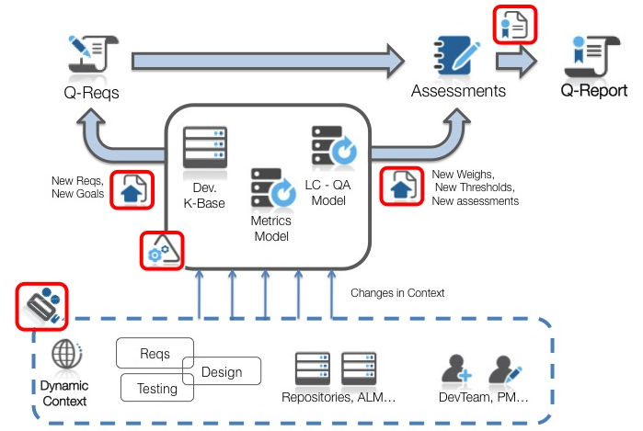
STEP 4: Prioritization Voting on the Fittingness and usability of the indicators
15 min
The determined quality indicators and metrics are prioritized by
Accuracy (how well the indicator describes the objective)
Feasibility (easiness to implement for the project)
Done in Google Drive for each template separately
Fill in your name and your voting in the table in under the template:

Slide 19
Step 5: Post Activities questionnaire and discussion
30 min
Discuss the outcome of the workshop
Benefits
Improvement ideas
Reflections to participants’ own needs for quality information

Slide 20
NEXT STEPS
Further design work to complete the metrics definitions
Implementing the metrics
U-QASAR tool
Start collecting and following the metric data

